Slide 1


INT -213 PYTHON PROJECT
SUBMITTED TO: GAGANDEEP KAUR

Slide 2

:TEAM MEMEBERS:
DUDALA HEMANTH - 11707422
HIMANSHU TRIVEDI - 11706873
CHALLA RUSHITH - 11708047

Slide 3
:INTRODUCTION:
THE PROJECT WHICH IS ALLOCATED TO US IS “DESIGNING A PYTHON QUIZ MODULE “,
COMPRISES OF DIFFERENT GUI INTERFACES:
REGISTRATION PAGE
MCQ QUESTIONS PAGE
RATING AND FEEDBACK PAGE.

Slide 4


:ROLE AND RESPONSIBILITY:

Slide 5
:DUDALA HEMANTH:
BRING UP THE OVERVIEW OF THE PROJECT AND WORK ALLOCATION.
ENTIRE DEVELOPMENT OF PYTHON CODE IS DONE BY HIM.
WORK OF DEVELOPING QUESTIONS PAGE IS DONE BY HIM
THE LOGICAL WAY OF MAKING PROJECT IS DONE BY HIM.
MAJOR WORK OF GUI INTERFACE IS DONE BY HIM.

Slide 6
:HIMANSHU TRIVEDI:
HE HELPED IN FRAMING THE PYTHON SUBJECT QUESTIONS ACCORDING TO THE DIFFICULTY LEVEL.
THE WORK OF DEVELOPING REGISTRATION FORM IS DONE BY HIM.
THE NON TECHNICAL WORK IS ALSO DONE BY HIM.

Slide 7
:CHALLA- RUSHITH:
HE HELPED IN THE DEVELOPMENT IN THE RATING AND THANKYOU PAGE IN LAST.
THE ENTIRE FINANCIAL HELP IS DONE BY HIM.
HE ALSO HELPED US IN THE TESTING PROCEDURE OF THE PROJECT.

Slide 8


:SCREENSHOTS OF GUI:

Slide 9
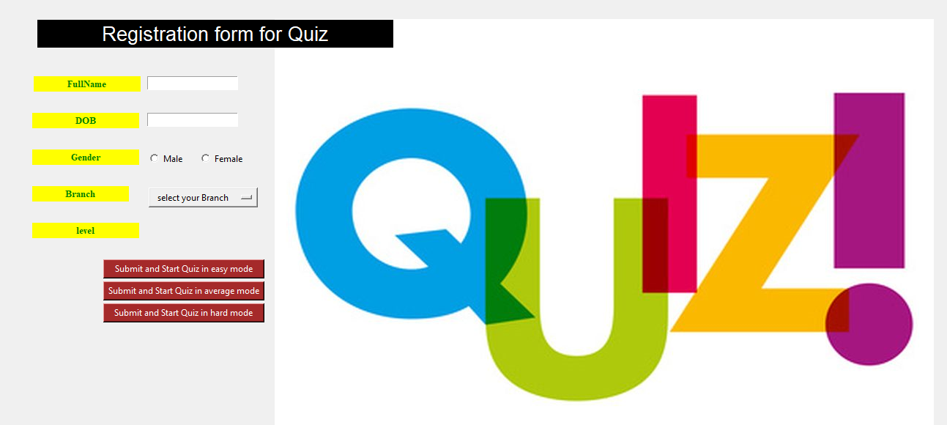
:REGISTRATON FORM:

Slide 10
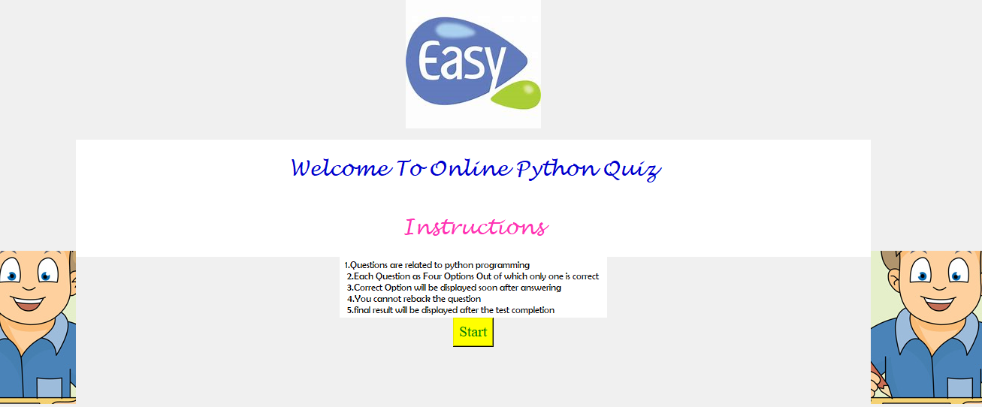
:EASY MODE SECTION:

Slide 11
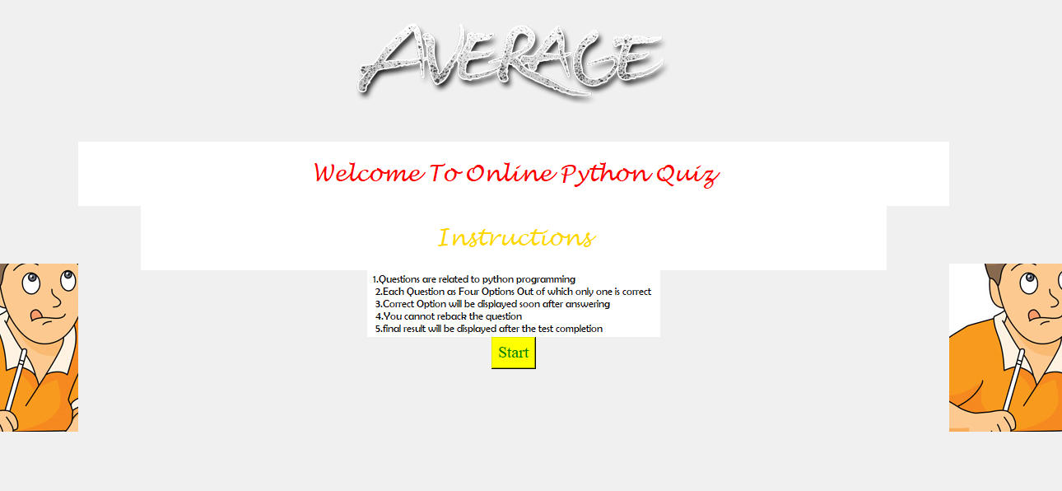
:AVERAGE MODE SECTION:

Slide 12
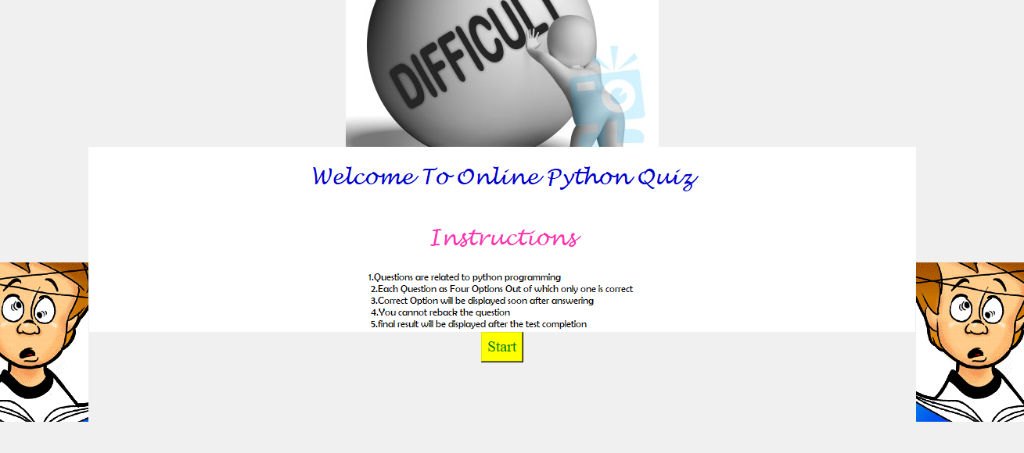
:HARD MODE SECTION:

Slide 13
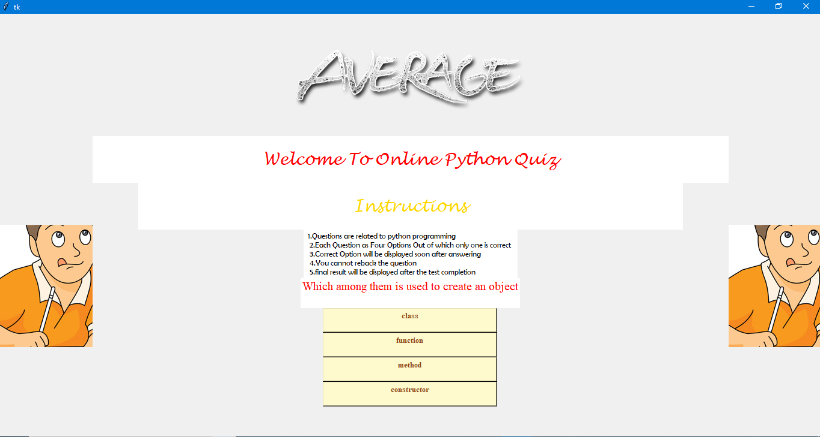
:MCQ PAGE:

Slide 14
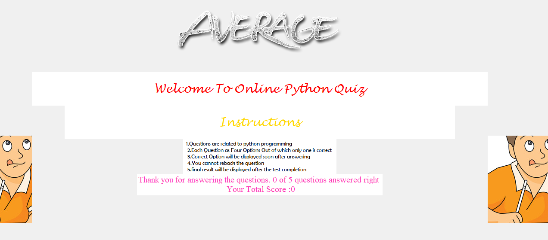
:RESULT PAGE:

Slide 15
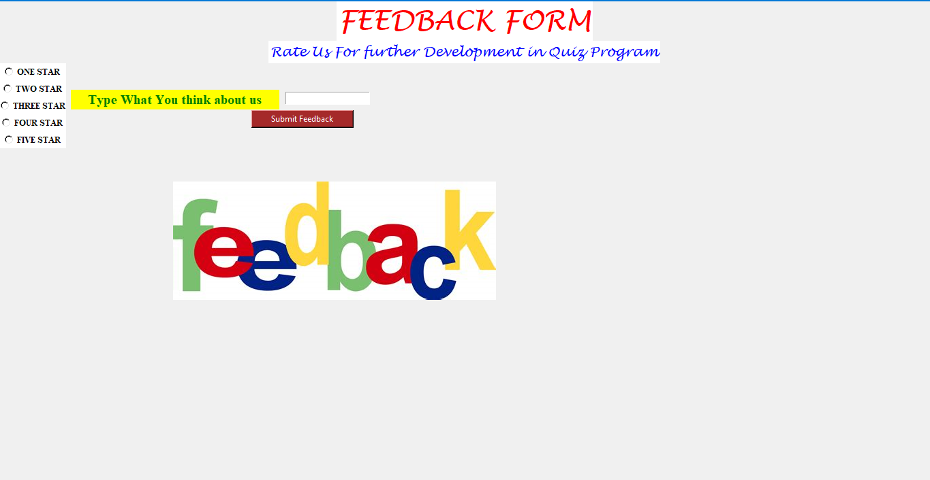
:RATING AND FEEDBACK PAGE:

Slide 16
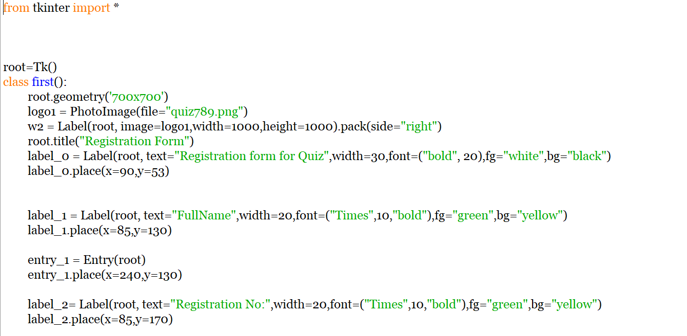
:SOURCE CODE 1: Registration Form

Slide 17
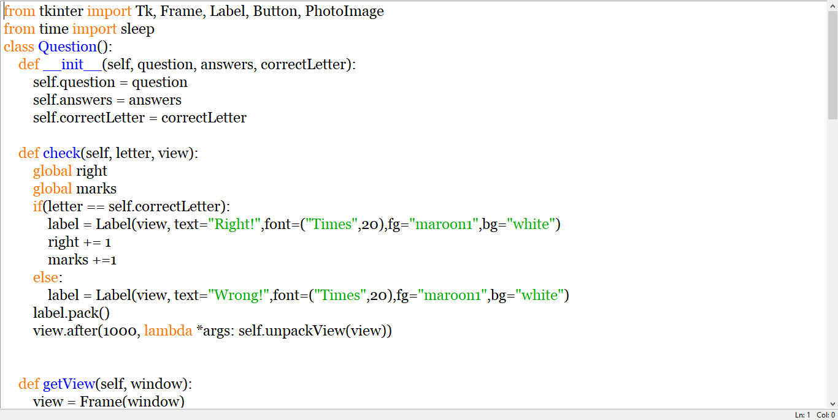
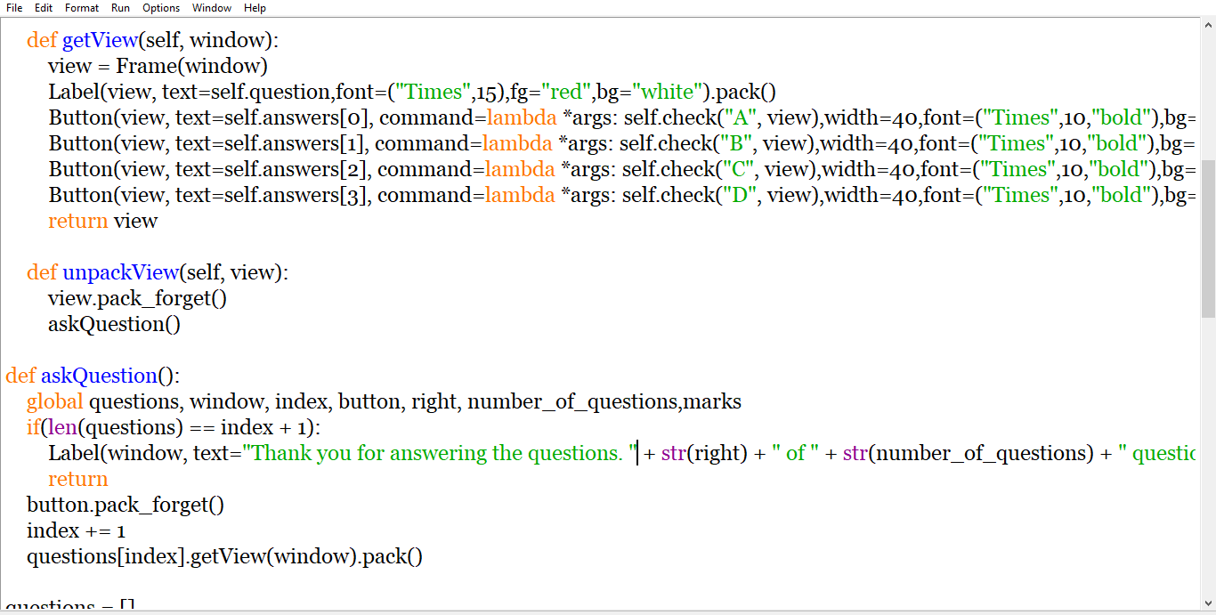
:SOURCE CODE 2: Questions mode

Slide 18
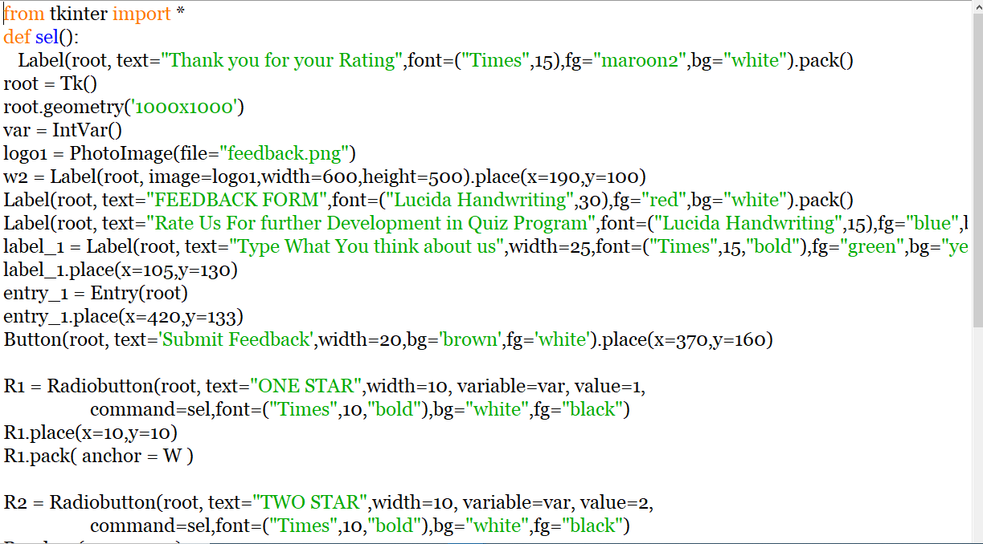
SOURCE CODE 3: FEEDBACK PAGE

Slide 19
:THANK YOU:

